Slide 1
Data Structures
and
Algorithms
CSCI 237 – Fall 2018

Slide 2
Graph Traversal Algorithms
Many problems require processing all graph vertices (and edges) in systematic fashion
The process of traversing all the nodes or vertices on a graph is called graph traversal
Graph traversal algorithms:
Depth-first search (DFS)
Breadth-first search (BFS)

Slide 3
Graph and Graph Traversals
Graph traversal techniques
DFS: Depth First Search
The DFS explore each possible path to its conclusion before another path is tried;
In other words go as a far as you can, until you don’t have a node to visit;
Otherwise, go back and try another way; Simply it can be called as “backtracking”.

Slide 4
Depth-First Search (DFS)
Visits graph’s vertices by always moving away from last visited vertex to unvisited one, backtracks if no adjacent unvisited vertex is available.
Uses a stack
a vertex is pushed onto the stack when it’s reached for the first time
a vertex is popped off the stack when it becomes a dead end, i.e., when there is no adjacent unvisited vertex
“Redraws” graph in tree-like fashion (with tree edges and back edges for undirected graph)

Slide 5
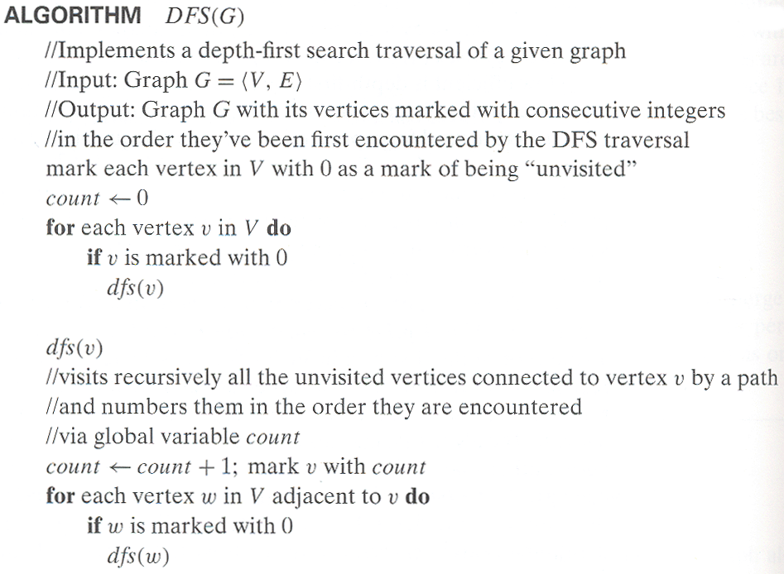
Pseudocode of DFS

Slide 6
Graph and Graph Traversals – DFS Example
Consider the following graph:
Adjacency List for this graph:
A B, C, E
B A, D, F
C A, G
D B
E A, F
F B, E
G C
A
B
C
E
D
F
G

Slide 7
Graph and Graph Traversals
(1) A depth-first search starting at A.
(2) Assume that the left edges in the shown graph are chosen before right edges.
(3) Assume that the search remembers previously visited nodes and will not repeat them.
(4) Repeat steps 2 and 3 until no more nodes can be visited.
(5) Repeat from step 1 for remaining nodes also.

Slide 8
Graph and Graph Traversals
A B, C, E
B A, D, F
C A, G
D B
E A, F
F B, E
G C
A
B
C
E
D
F
G
NULL
Node visit order: A, B, D, F, E, C, G
E
F
B
A
D
B
A
F
B
A
F
B
A
D
B
A
G
C
A
A
A
B
A
B
A
B
A
B
A
A
C
A
C
A
A

Slide 9
Graph and Graph Traversals
A B, C, E
B A, D, F
C A, G
D B
E A, F
F B, E
G C
A
B
C
E
D
F
G
NULL
Node visit order: A, B, D, F, E, C, G
E
F
B
A
D
B
A
F
B
A
F
B
A
D
B
A
G
C
A
A
A
B
A
B
A
B
A
B
A
A
C
A
C
A
A

Slide 10
Graph and Graph Traversals
Some definitions:
Unexplored vertex: The node or vertex which is not yet visited. Whenever a new unvisited vertex is reached for the first time, it is attached as a child to the vertex from which it is being reached. Such an edge is called a tree edge because the set of all such edges forms a tree.
Visited vertex: The node or vertex which is visited is called ‘visited vertex’
i.e. can be called as “current node”.
Unexplored edge: The edge or path which is not yet traversed.
Discovery edge: It is opposite to unexplored edge, the path which is already traversed is known as discovery edge.
Back edge: If the current node has no unvisited neighbors we need to backtrack to its parent node. The path used in back tracking is called back edge.
Such an edge leads to a previously visited vertex other than its immediate predecessor (i.e., its parent in the tree). In other words it connects a vertex to its ancestor, other than the parent, in the depth-first search forest.
Cross edge:

Slide 11
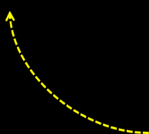




Example: DFS traversal of undirected graph
a
b
c
d
Adjacency List:
a | b,e,f
b | a, f, g
c | d, g
d | c, h
e | a, f
f | a, b, e
g | b, c, h
h | g, d
e
f
g
h
DFS tree:
DFS traversal stack:
A
B
A
F
B
A
E
F
B
A
F
B
A
B
A
G
B
A
C
G
B
A
D
C
G
B
A
H
D
C
G
B
A
b
f
g
D
C
G
B
A
e
c
G
B
A
C
G
B
A
A
B
A
Notes:
Traversal using alphabetical order of vertices. Work through this example in detail,
showing the traversal by highlighting edges on the graph and showing how the stack
evolves:
8 h 3
7 d 4 stack shown growing upwards
4 e 1 6 c 5 number on left is order that vertex was pushed onto stack
3 f 2 5 g 6 number on right is order that vertex was popped from stack
2 b 7 overlap is because after e, f are popped off stack, g and c
1 a 8 are pushed onto stack in their former locations.
order pushed onto stack: a b f e g c d h
order popped from stack: e f h d c g b a
* show dfs tree as it gets constructed, back edges

Slide 12
Notes on DFS
DFS can be implemented with graphs represented as:
adjacency matrices: Θ(V²)
adjacency lists: Θ(|V|+|E|)
Yields two distinct ordering of vertices:
order in which vertices are first encountered (pushed onto stack)
order in which vertices become dead-ends (popped off stack)
Applications:
checking connectivity, finding connected components
checking acyclicity
finding articulation points and biconnected components
searching state-space of problems for solution (AI)

Slide 13
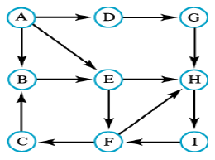
Graph and Graph Traversals
You are given the following directed graph trace the DFS traversal. Complete the travel tree.
DFS Traversal:
a, b, e, f, c, h, i, d, g
Adjacency List:
a | b,d,e
b | e
c | b
d | g
e | f,h
f | c,h
g | h
h | i
i | f

Slide 14
Breadth-first search (BFS)
Visits graph vertices by moving across to all the neighbors of last visited vertex
Each node on the same level is checked before the search proceeds to the next level.
Instead of a stack, BFS uses a queue
Q: Why is a queue data structure most appropriate for BFS?
Similar to level-by-level tree traversal
“Redraws” graph in tree-like fashion (with tree edges and cross edges for undirected graph)

Slide 15
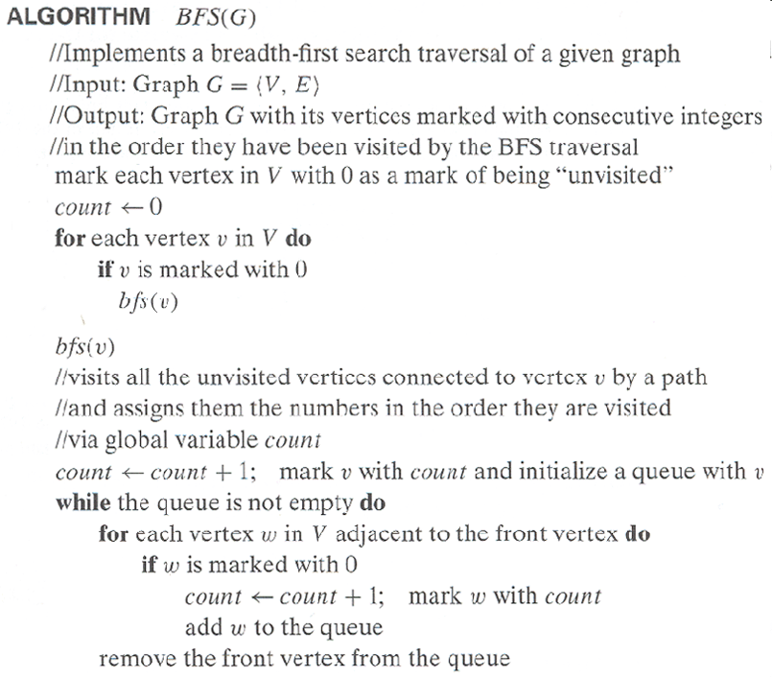
Pseudocode of BFS

Slide 16
Graph and Graph Traversals
Breadth First Search Steps:
1. Mark all the vertices as unvisited;
2. Choose any vertex say ‘v’, mark it as visited and put it on the back of the queue;
3. Now, for each vertex on the list, examine in same order all the vertices adjacent to ‘v’;
4. When all the unvisited vertices adjacent to v have been marked as visited and put it on the rear of the queue;
5. Remove a vertex from the front of the queue and repeat this procedure;
6. Continue this procedure until the list is empty.

Slide 17
Graph and Graph Traversals
Consider the following graph:
Adjacency List Queue
A
ECB
FDEC
GFDE
GFD
GF
G
empty
A
A B, C, E
B A, D, F
C A, G
D B
E A, F
F B, E
G C
B
C
E
D
F
G
A
B
C
E
D
F
G
NODE TRAVERSAL ORDER
A-B-C-E-D-F-G

Slide 18
Graph and Graph Traversals
Given the following directed graph trace the BFS traversal. Assume that the vertices are considered in the order of their label/name.

Slide 19

Graph and Graph Traversals
Adjacency List:
Queue:
Traversal Tree
a | b,d,e
b | e
c | b
d | g
e | f,h
f | c,h
g | h
h | i
i | f
a
edb
ed
ge
hfg
hf
ch
ic
i
empty
A
B
C
E
D
G
F
H
C
I
Traversal List
A-B-D-E-G-F-H-C-I

Slide 20
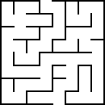
Graph and Graph Traversals
Representing a maze as a graph:
Given the following maze
With vertices and edges

Slide 21
Graph and Graph Traversals
Representing a maze as a graph:
Given the following maze
* Figures from sfu.ca
(1) Find any “important” points in the maze and call them nodes;
(2) Connect nodes with edges when they are connected in the graph.

Slide 22
Graph and Graph Traversals
Representing a maze as a graph:
Given the following maze Corresponding graph
With nodes and edges

Slide 23
Graph and Graph Traversals
Some points to ponder!
Now that we have a graph representing the maze
We can ask how about a path from ‘a’ to ‘k’ in that graph.
… or the shortest path, or the path that visits the most places on its way, or…
We didn't really have to select only “important” points as our vertices.
We could have made every grid location a vertex, and joined them as appropriate.
That would have created a much bigger graph (64 nodes, many with degree 2), but still captured everything about the maze.
Note: The number of edges at a node is the nodes degree.
Maybe that graph would have been better: getting the shortest path would have been more meaningful.

Slide 24
Example of BFS traversal of undirected graph
a
b
c
d
e
f
g
h
BFS traversal queue:
BFS tree:

Slide 25
Notes on BFS
BFS has same efficiency as DFS and can be implemented with graphs represented as:
adjacency matrices: Θ(V²)
adjacency lists: Θ(|V|+|E|)
Yields single ordering of vertices (order added/deleted from queue is the same)
Applications: same as DFS, but can also find paths from a vertex to all other vertices with the smallest number of edges

Slide 26

Questions ?!
DFS, BFS

